Slide 1
This document is a result of work by ESnet for the Fasterdata knowledgebase (http://fasterdata.es.net) and is licensed under CC BY-NC-ND 4.0 (https://creativecommons.org/licenses/by-nc-nd/4.0/).
© 2015, The Regents of the University of California, through Lawrence Berkeley National Laboratory (subject to receipt of any required approvals from the U.S. Dept. of Energy). All rights reserved.
NOTICE. This material is owned by the U.S. Department of Energy. As such, the U.S. Government has been granted for itself and others acting on its behalf a paid-up, nonexclusive, irrevocable, worldwide license in the material to reproduce, prepare derivative works, and perform publicly and display publicly.
The Science DMZ*: A Network Design Pattern for Data-Intensive Science
Energy Sciences Network (ESnet)
Lawrence Berkeley National Laboratory
Last Updated July 16th, 2015
* Science DMZ is a trademark of The Energy Sciences Network (ESnet)

Slide 2
Overview
Science DMZ Motivation and Introduction
Science DMZ Architecture
Network Monitoring
Data Transfer Nodes & Applications
Science DMZ Security
User Engagement
Wrap Up
© 2015, The Regents of the University of California, through Lawrence Berkeley National Laboratory and is licensed under CC BY-NC-ND 4.0
<number> – ESnet Science Engagement (engage@es.net) - 06/01/2018
Notes:
<number>

Slide 3
Motivation
Networks are an essential part of data-intensive science
Connect data sources to data analysis
Connect collaborators to each other
Enable machine-consumable interfaces to data and analysis resources (e.g. portals), automation, scale
Performance is critical
Exponential data growth
Constant human factors
Data movement and data analysis must keep up
Effective use of wide area (long-haul) networks by scientists has historically been difficult
© 2015, The Regents of the University of California, through Lawrence Berkeley National Laboratory and is licensed under CC BY-NC-ND 4.0
<number> – ESnet Science Engagement (engage@es.net) - 06/01/2018
Notes:
Human factors – attention span, ability to manage complexity – these are constant
There is a huge amount of promise in data-intensive science. Effective use of networks can help realize those benefits.
The Science DMZ model helps address the difficulties scientists often experience with using networks.
<number>

Slide 4
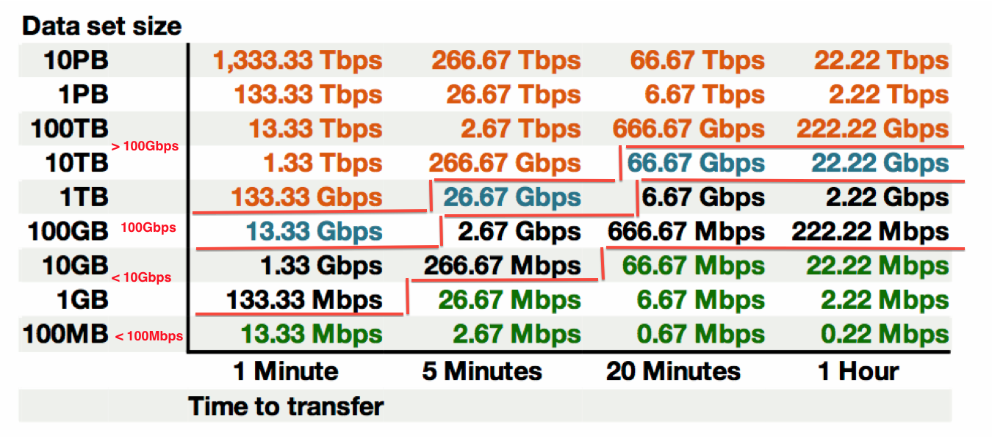
Data Mobility in a Given Time Interval
This table available at:
http://fasterdata.es.net/fasterdata-home/requirements-and-expectations/
© 2015, The Regents of the University of California, through Lawrence Berkeley National Laboratory and is licensed under CC BY-NC-ND 4.0
<number> – ESnet Science Engagement (engage@es.net) - 06/01/2018
Notes:
This succinctly describes what the end to end data path must achieve – network, hosts, storage, application
Green: <= 100Mbps Throughput (almost all domestic locations can do this) – less than Fast Ethernet!
Black: 100Mbps to 10Gbps Throughput (most major research institutions can do this, if its running clean)
Blue 10Gbps to 100Gbps Throughput (emerging at major locations)
Orange > 100Gbps Throughput (future for many)
Note: 1TB/hour and 100TB/week fit easily within 10G of throughput
<number>

Slide 5
The Central Role of the Network
The very structure of modern science assumes science networks exist: high performance, feature rich, global scope
What is “The Network” anyway?
“The Network” is the set of devices and applications involved in the use of a remote resource
This is not about supercomputer interconnects
This is about data flow from experiment to analysis, between facilities, etc.
User interfaces for “The Network” – portal, data transfer tool, workflow engine
Therefore, servers and applications must also be considered
What is important? Ordered list:
Correctness
Consistency
Performance
© 2015, The Regents of the University of California, through Lawrence Berkeley National Laboratory and is licensed under CC BY-NC-ND 4.0
<number> – ESnet Science Engagement (engage@es.net) - 06/01/2018
Notes:
Networks are key. However, the user interface runs on systems at the edges.
The ordered list of important items is derived from the users of the network:
1) If a tool doesn’t behave correctly, the tool is broken – get another tool
2) If the tool doesn’t behave consistently, I can’t organize my life
3) Among the tools that behave correctly and consistently, choose the tool with the required performance that is easiest to use
<number>

Slide 6
TCP – Ubiquitous and Fragile
Networks provide connectivity between hosts – how do hosts see the network?
From an application’s perspective, the interface to “the other end” is a socket
Communication is between applications – mostly over TCP
TCP – the fragile workhorse
TCP is (for very good reasons) timid – packet loss is interpreted as congestion
Packet loss in conjunction with latency is a performance killer
Like it or not, TCP is used for the vast majority of data transfer applications (more than 95% of ESnet traffic is TCP)
© 2015, The Regents of the University of California, through Lawrence Berkeley National Laboratory and is licensed under CC BY-NC-ND 4.0
<number> – ESnet Science Engagement (engage@es.net) - 06/01/2018
Notes:
The application sees the network as a socket.
The socket interface does not provide path diagnostics or other troubleshooting information.
TCP behaves as it does because of measures taken in the 1980s to fix the congestion collapse of the Internet
TCP makes a promise to the application – TCP will get the data to the other end, or TCP will return an error. TCP makes no promises about performance.
<number>

Slide 7
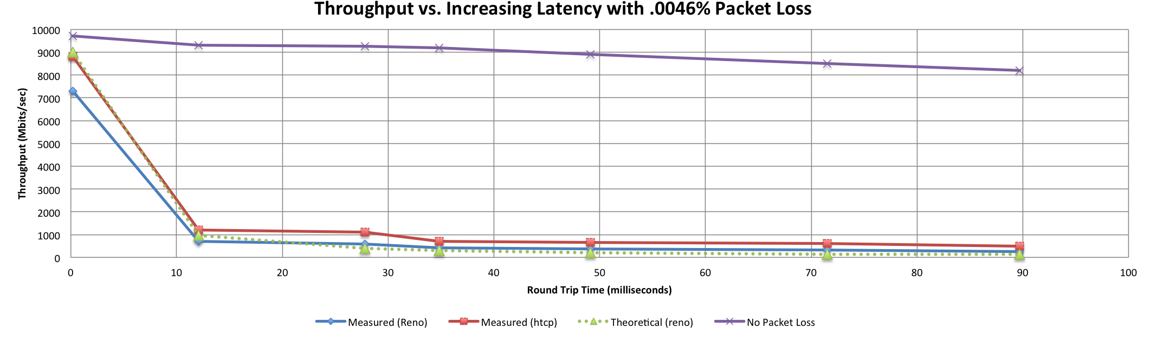
A small amount of packet loss makes a huge difference in TCP performance
With loss, high performance beyond metro distances is essentially impossible
Local
(LAN)
International
Metro Area
Regional
Continental
Measured (TCP Reno)
Measured (HTCP)
Theoretical (TCP Reno)
Measured (no loss)
© 2015, The Regents of the University of California, through Lawrence Berkeley National Laboratory and is licensed under CC BY-NC-ND 4.0
<number> – ESnet Science Engagement (engage@es.net) - 06/01/2018
Notes:
This is an annotated version of the plot from the Science DMZ paper
Beyond your metro area, zero loss is essentially required for high performance
Where are your collaborators? Where are your users?
When global collaboration is the norm, nobody can afford to be a local-only resource
<number>

Slide 8
Working With TCP In Practice
Far easier to support TCP than to fix TCP
People have been trying to fix TCP for years – limited success
Like it or not we’re stuck with TCP in the general case
Pragmatically speaking, we must accommodate TCP
Sufficient bandwidth to avoid congestion
Zero packet loss
Verifiable infrastructure
Networks are complex
Must be able to locate problems quickly
Small footprint is a huge win – small number of devices so that problem isolation is tractable
© 2015, The Regents of the University of California, through Lawrence Berkeley National Laboratory and is licensed under CC BY-NC-ND 4.0
<number> – ESnet Science Engagement (engage@es.net) - 06/01/2018
Notes:
Do not underestimate the value of three TCP improvements:
RFC1323 (window scaling)
Kernel autotuning
Improved congestion algorithms
However, loss + latency is still a performance killer.
TCP must be accommodated – this is our job as engineers and architects
<number>

Slide 9
Putting A Solution Together
Effective support for TCP-based data transfer
Design for correct, consistent, high-performance operation
Design for ease of troubleshooting
Easy adoption is critical
Large laboratories and universities have extensive IT deployments
Drastic change is prohibitively difficult
Cybersecurity – defensible without compromising performance
Borrow ideas from traditional network security
Traditional DMZ
Separate enclave at network perimeter (“Demilitarized Zone”)
Specific location for external-facing services
Clean separation from internal network
Do the same thing for science – Science DMZ
© 2015, The Regents of the University of California, through Lawrence Berkeley National Laboratory and is licensed under CC BY-NC-ND 4.0
<number> – ESnet Science Engagement (engage@es.net) - 06/01/2018
Notes:
In order to accommodate TCP, we need a pragmatic engineering solution that:
Addresses the needs
Is implementable given financial, policy, and cultural constraints
Can be defended – we cannot ignore security
<number>

Slide 10
Overview
Science DMZ Motivation and Introduction
Science DMZ Architecture
Network Monitoring
Data Transfer Nodes & Applications
Science DMZ Security
User Engagement
Wrap Up
© 2015, The Regents of the University of California, through Lawrence Berkeley National Laboratory and is licensed under CC BY-NC-ND 4.0
<number> – ESnet Science Engagement (engage@es.net) - 06/01/2018
Notes:
<number>

Slide 11
The Science DMZ Design Pattern
Dedicated Systems for Data Transfer
Data Transfer Node
High performance
Configured specifically for data transfer
Proper tools
Science DMZ
Dedicated network location for high-speed data resources
Appropriate security
Easy to deploy - no need to redesign the whole network
perfSONAR
Enables fault isolation
Verify correct operation
Widely deployed in ESnet and other networks, as well as sites and facilities
Network Architecture
Performance Testing & Measurement
© 2015, The Regents of the University of California, through Lawrence Berkeley National Laboratory and is licensed under CC BY-NC-ND 4.0
<number> – ESnet Science Engagement (engage@es.net) - 06/01/2018
Notes:
The Science DMZ design pattern is a set of composable ideas, including:
The architectural element itself – the Science DMZ enclave
Appropriate security that does not impact performance
Dedicated systems – Data Transfer Nodes
perfSONAR
The elements of the Science DMZ can be combined in a variety of ways depending on the need
<number>

Slide 12
Abstract or Prototype Deployment
Add-on to existing network infrastructure
All that is required is a port on the border router
Small footprint, pre-production commitment
Easy to experiment with components and technologies
DTN prototyping
perfSONAR testing
Limited scope makes security policy exceptions easy
Only allow traffic from partners
Add-on to production infrastructure – lower risk
© 2015, The Regents of the University of California, through Lawrence Berkeley National Laboratory and is licensed under CC BY-NC-ND 4.0
<number> – ESnet Science Engagement (engage@es.net) - 06/01/2018

Slide 13
Local And Wide Area Data Flows
© 2015, The Regents of the University of California, through Lawrence Berkeley National Laboratory and is licensed under CC BY-NC-ND 4.0
<number> – ESnet Science Engagement (engage@es.net) - 06/01/2018
Notes:
The green data path is susceptible to TCP performance problems stemming from packet loss combined with long distances
The red data path is very low latency – loss matters much less here (though too much loss will still cause problems)
Remember the throughput vs. latency graph
<number>

Slide 14
Support For Multiple Projects
Science DMZ architecture allows multiple projects to put DTNs in place
Modular architecture
Centralized location for data servers
This may or may not work well depending on institutional politics
Issues such as physical security can make this a non-starter
On the other hand, some shops already have service models in place
On balance, this can provide a cost savings – it depends
Central support for data servers vs. carrying data flows
How far do the data flows have to go?
© 2015, The Regents of the University of California, through Lawrence Berkeley National Laboratory and is licensed under CC BY-NC-ND 4.0
<number> – ESnet Science Engagement (engage@es.net) - 06/01/2018

Slide 15
Multiple Projects
© 2015, The Regents of the University of California, through Lawrence Berkeley National Laboratory and is licensed under CC BY-NC-ND 4.0
<number> – ESnet Science Engagement (engage@es.net) - 06/01/2018

Slide 16
Supercomputer Center Deployment
High-performance networking is assumed in this environment
Data flows between systems, between systems and storage, wide area, etc.
Global filesystem often ties resources together
Portions of this may not run over Ethernet (e.g. IB)
Implications for Data Transfer Nodes
“Science DMZ” may not look like a discrete entity here
By the time you get through interconnecting all the resources, you end up with most of the network in the Science DMZ
This is as it should be – the point is appropriate deployment of tools, configuration, policy control, etc.
Office networks can look like an afterthought, but they aren’t
Deployed with appropriate security controls
Office infrastructure need not be sized for science traffic
© 2015, The Regents of the University of California, through Lawrence Berkeley National Laboratory and is licensed under CC BY-NC-ND 4.0
<number> – ESnet Science Engagement (engage@es.net) - 06/01/2018

Slide 17
Supercomputer Center
© 2015, The Regents of the University of California, through Lawrence Berkeley National Laboratory and is licensed under CC BY-NC-ND 4.0
<number> – ESnet Science Engagement (engage@es.net) - 06/01/2018
Notes:
Applying the Science DMZ design patterns to a supercomputer center
Note global filesystem – avoids double-copy workflow between DTNs and compute resources
DTNs are not part of major computational resource, and so are not entangled with its config
Science DMZ does not look discrete – however, the elements are here
Firewall appropriately placed
Security for major resources and DTNs implemented in network core
PerfSONAR for performance assurance
<number>

Slide 18
Supercomputer Center Data Path
© 2015, The Regents of the University of California, through Lawrence Berkeley National Laboratory and is licensed under CC BY-NC-ND 4.0
<number> – ESnet Science Engagement (engage@es.net) - 06/01/2018
Notes:
DTNs are not part of major computational resource, and so are not entangled with its config
Note virtual circuit path (OSCARS, ION, SDN, etc)
<number>

Slide 19
Major Data Site Deployment
In some cases, large scale data service is the major driver
Huge volumes of data (Petabytes or more) – ingest, export
Large number of external hosts accessing/submitting data
Single-pipe deployments don’t work
Everything is parallel
Networks (Nx10G LAGs, soon to be Nx100G)
Hosts – data transfer clusters, no individual DTNs
WAN connections – multiple entry, redundant equipment
Choke points (e.g. firewalls) just cause problems
© 2015, The Regents of the University of California, through Lawrence Berkeley National Laboratory and is licensed under CC BY-NC-ND 4.0
<number> – ESnet Science Engagement (engage@es.net) - 06/01/2018

Slide 20
Data Site – Architecture
© 2015, The Regents of the University of California, through Lawrence Berkeley National Laboratory and is licensed under CC BY-NC-ND 4.0
<number> – ESnet Science Engagement (engage@es.net) - 06/01/2018
Notes:
Major data resource (e.g. LHC Tier1)
Lots of parallelism (data transfer clusters)
Firewalls as appropriate
PerfSONAR
<number>

Slide 21
Data Site – Data Path
© 2015, The Regents of the University of California, through Lawrence Berkeley National Laboratory and is licensed under CC BY-NC-ND 4.0
<number> – ESnet Science Engagement (engage@es.net) - 06/01/2018
Notes:
The loss-sensitive data path covers the entire network front-end
However – note that the Science DMZ principles are all still here
Especially note security – would you want to drag all this through the enterprise firewall? Far better to do the security in the Science DMZ.
<number>

Slide 22
Distributed Science DMZ
Fiber-rich environment enables a distributed Science DMZ
No need to accommodate all equipment in one location
Allows the deployment of institutional science service
WAN services arrive at the site in the normal way
Dark fiber distributes connectivity to Science DMZ services throughout the site
Departments with their own networking groups can manage their own local Science DMZ infrastructure
Facilities or buildings can be served without building up the business network to support those flows
Security is more complex
Remote infrastructure must be monitored
Several technical remedies exist (arpwatch, no DHCP, separate address space, etc.)
Solutions depend on relationships with security groups
© 2015, The Regents of the University of California, through Lawrence Berkeley National Laboratory and is licensed under CC BY-NC-ND 4.0
<number> – ESnet Science Engagement (engage@es.net) - 06/01/2018

Slide 23
Distributed Science DMZ – Dark Fiber
© 2015, The Regents of the University of California, through Lawrence Berkeley National Laboratory and is licensed under CC BY-NC-ND 4.0
<number> – ESnet Science Engagement (engage@es.net) - 06/01/2018
Notes:
This provides distributed connectivity to a central Science DMZ
<number>

Slide 24
Multiple Science DMZs – Dark Fiber
© 2015, The Regents of the University of California, through Lawrence Berkeley National Laboratory and is licensed under CC BY-NC-ND 4.0
<number> – ESnet Science Engagement (engage@es.net) - 06/01/2018
Notes:
In this case, each Science DMZ can be run separately (e.g. by individual departments or laboratories)
<number>

Slide 25
Development Environment
One thing that often happens is that an early power user of the Science DMZ is the network engineering group that builds it
Service prototyping
Deployment of test applications for other user groups to demonstrate value
The production Science DMZ is just that – production
Once users are on it, you can’t take it down to try something new
Stuff that works tends to attract workload
Take-home message: plan for multiple Science DMZs from the beginning – at the very least you’re going to need one for yourself
The Science DMZ model easily accommodates this
© 2015, The Regents of the University of California, through Lawrence Berkeley National Laboratory and is licensed under CC BY-NC-ND 4.0
<number> – ESnet Science Engagement (engage@es.net) - 06/01/2018
Notes:
Example of workload – ALS DTN became central to most data handling tasks on the beamline within about a month of deployment
The Science DMZ model can easily be replicated because of its modularity
<number>

Slide 26
Science DMZ – Flexible Design Pattern
The Science DMZ design pattern is highly adaptable to research
Deploying a research Science DMZ is straightforward
The basic elements are the same
Capable infrastructure designed for the task
Test and measurement to verify correct operation
Security policy well-matched to the environment, application set is strictly limited to reduce risk
Connect the research DMZ to other resources as appropriate
The same ideas apply to supporting an SDN effort
Test/research areas for development
Transition to production as technology matures and need dictates
One possible trajectory follows…
© 2015, The Regents of the University of California, through Lawrence Berkeley National Laboratory and is licensed under CC BY-NC-ND 4.0
<number> – ESnet Science Engagement (engage@es.net) - 06/01/2018
Notes:
The next couple are examples of integrating SDN into a DMZ environment
1st it is experimental, then it gradually moves into production.
<number>

Slide 27
Multiple Ingress Flows, Common Egress
Hosts will typically send packets at the speed of their interface (1G, 10G, etc.)
Instantaneous rate, not average rate
If TCP has window available and data to send, host sends until there is either no data or no window
Hosts moving big data (e.g. DTNs) can send large bursts of back-to-back packets
This is true even if the average rate as measured over seconds is slower (e.g. 4Gbps)
On microsecond time scales, there is often congestion
Router or switch must queue packets or drop them
© 2015, The Regents of the University of California, through Lawrence Berkeley National Laboratory and is licensed under CC BY-NC-ND 4.0
<number> – ESnet Science Engagement (engage@es.net) - 06/01/2018
Notes:
A brief introduction to the impacts of buffering on network traffic. Key points:
- Host interfaces ‘burst’ at line rate, and then wait (e.g. it’s binary behavior, not a nice steady pacing at some average rate)
- multiple ingress flows behave differently depending on the architecture of the switch. If its ‘shared’ memory, all may be using the same memory buffer. If each interface has its own, then 1 or 2 bursting may be less impactful on the rest of the interfaces.
- buffer bloat is typically not a concern in a Science DMZ
<number>

Slide 28
Router and Switch Output Queues
Interface output queue allows the router or switch to avoid causing packet loss in cases of momentary congestion
In network devices, queue depth (or ‘buffer’) is often a function of cost
Cheap, fixed-config LAN switches (especially in the 10G space) have inadequate buffering. Imagine a 10G ‘data center’ switch as the guilty party
Cut-through or low-latency Ethernet switches typically have inadequate buffering (the whole point is to avoid queuing!)
Expensive, chassis-based devices are more likely to have deep enough queues
Juniper MX and Alcatel-Lucent 7750 used in ESnet backbone
Other vendors make such devices as well - details are important
Thx to Jim: http://people.ucsc.edu/~warner/buffer.html
This expense is one driver for the Science DMZ architecture – only deploy the expensive features where necessary
© 2015, The Regents of the University of California, through Lawrence Berkeley National Laboratory and is licensed under CC BY-NC-ND 4.0
<number> – ESnet Science Engagement (engage@es.net) - 06/01/2018
Notes:
Goes along with the previous – output is just as important as input
<number>

Slide 29
Output Queue Drops – Common Locations
© 2015, The Regents of the University of California, through Lawrence Berkeley National Laboratory and is licensed under CC BY-NC-ND 4.0
<number> – ESnet Science Engagement (engage@es.net) - 06/01/2018
Notes:
In the outbound direction, traffic from the cluster goes from 10G to 1G on the department core switch – the 10G DTN will burst, causing loss if the 1G output queue is too shallow
In the outbound direction, many 1G workstations can congest a single 1G uplink port
In the inbound direction, 10G of WAN traffic goes to a 1G port facing the department core switch – likely loss location (and on the wide area path to the DTN!)
There are a lot of networks with this sort of problem.
The best way to find the problem is to use perfSONAR
<number>

Slide 30
Overview
Science DMZ Motivation and Introduction
Science DMZ Architecture
Network Monitoring
Data Transfer Nodes & Applications
Science DMZ Security
User Engagement
Wrap Up
© 2015, The Regents of the University of California, through Lawrence Berkeley National Laboratory and is licensed under CC BY-NC-ND 4.0
<number> – ESnet Science Engagement (engage@es.net) - 06/01/2018
Notes:
<number>

Slide 31

Performance Monitoring
Everything may function perfectly when it is deployed
Eventually something is going to break
Networks and systems are complex
Bugs, mistakes, …
Sometimes things just break – this is why we buy support contracts
Must be able to find and fix problems when they occur
Must be able to find problems in other networks (your network may be fine, but someone else’s problem can impact your users)
TCP was intentionally designed to hide all transmission errors from the user:
“As long as the TCPs continue to function properly and the internet system does not become completely partitioned, no transmission errors will affect the users.” (From RFC793, 1981)
© 2015, The Regents of the University of California, through Lawrence Berkeley National Laboratory and is licensed under CC BY-NC-ND 4.0
<number> – ESnet Science Engagement (engage@es.net) - 06/01/2018
Notes:
Remember – TCP promises reliable data delivery, not performance
In order for scientists to see high-performance correct behavior consistently, network engineers must be able to find and fix problems quickly.
Waiting around for trouble tickets is clearly the wrong approach
Not all problems are immediately obvious – many are known as “soft failures”
<number>

Slide 32
Soft Network Failures – Hidden Problems
Hard failures are well-understood
Link down, system crash, software crash
Traditional network/system monitoring tools designed to quickly find hard failures
Soft failures result in degraded capability
Connectivity exists
Performance impacted
Typically something in the path is functioning, but not well
Soft failures are hard to detect with traditional methods
No obvious single event
Sometimes no indication at all of any errors
Independent testing is the only way to reliably find soft failures
© 2015, The Regents of the University of California, through Lawrence Berkeley National Laboratory and is licensed under CC BY-NC-ND 4.0
<number> – ESnet Science Engagement (engage@es.net) - 06/01/2018
Notes:
If something is down hard, it’s easy to find
Soft failures are often visible only from the end systems
This is what makes perfSONAR so valuable – it behaves as an end system behaves, but it measures what the network does
Remember – we want to find the problems BEFORE the users do
<number>

Slide 33
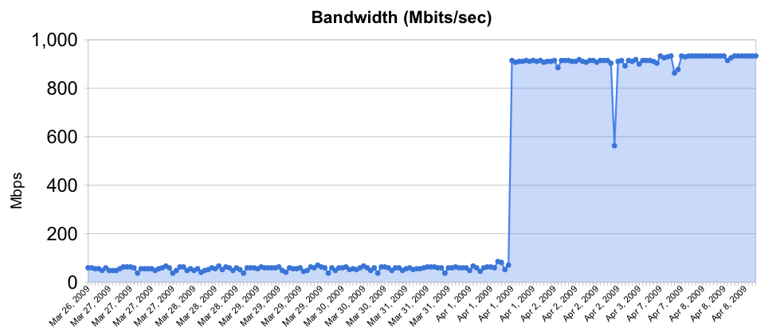
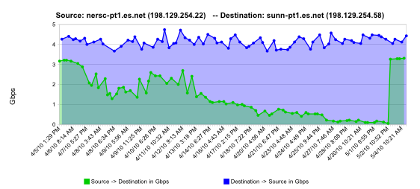
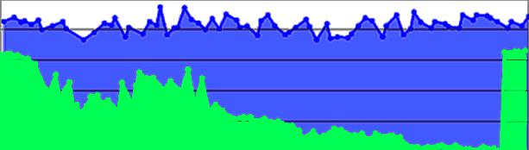
Sample Soft Failures
Rebooted router with full route table
normal performance
Gb/s
degrading performance
Gradual failure of optical line card
repair
one month
© 2015, The Regents of the University of California, through Lawrence Berkeley National Laboratory and is licensed under CC BY-NC-ND 4.0
<number> – ESnet Science Engagement (engage@es.net) - 06/01/2018
Notes:
2 quick examples of soft failures:
The first of these was a Cisco 6509 that had over-filled its route table due to a misconfiguration, but the config had been fixed. The performance problem persisted until the router was rebooted. This could not have been found by auditing the configuration.
The second is a relatively common problem – in a big network there are a lot of pluggable optics packs, and sometimes they just go bad. Often they cause performance problems (soft failure) for a long time before they finally die (hard failure)
<number>

Slide 34
Testing Infrastructure – perfSONAR
perfSONAR is:
A widely-deployed test and measurement infrastructure
ESnet, Internet2, US regional networks, international networks
Laboratories, supercomputer centers, universities
A suite of test and measurement tools
A collaboration that builds and maintains the toolkit
By installing perfSONAR, a site can leverage over 1100 test servers deployed around the world
perfSONAR is ideal for finding soft failures
Alert to existence of problems
Fault isolation
Verification of correct operation
© 2015, The Regents of the University of California, through Lawrence Berkeley National Laboratory and is licensed under CC BY-NC-ND 4.0
<number> – ESnet Science Engagement (engage@es.net) - 06/01/2018
Notes:
perfSONAR is the gold standard tool for performance testing, measurement, and interdomain troubleshooting in science networks
<number>

Slide 35
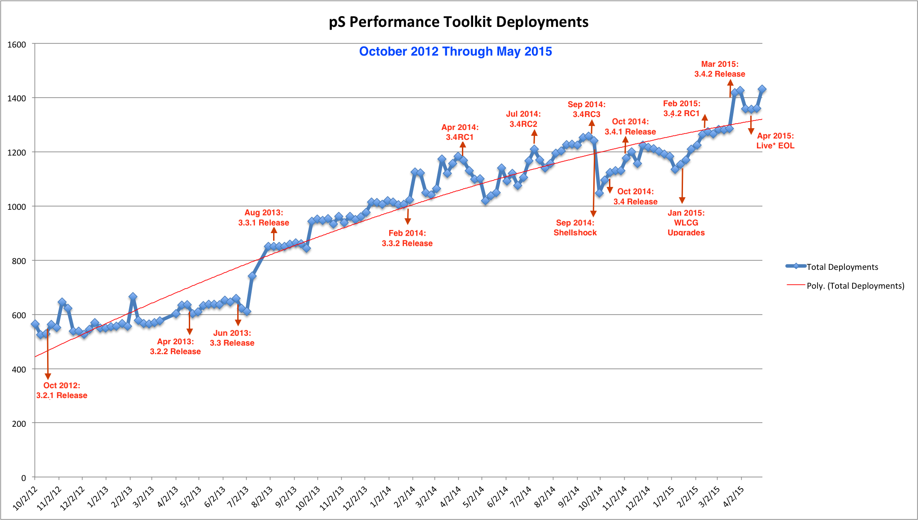
perfSONAR Deployment Footprint
© 2015, The Regents of the University of California, through Lawrence Berkeley National Laboratory and is licensed under CC BY-NC-ND 4.0
<number> – ESnet Science Engagement (engage@es.net) - 06/01/2018
Notes:
Deployment curve through April 2014
<number>

Slide 36
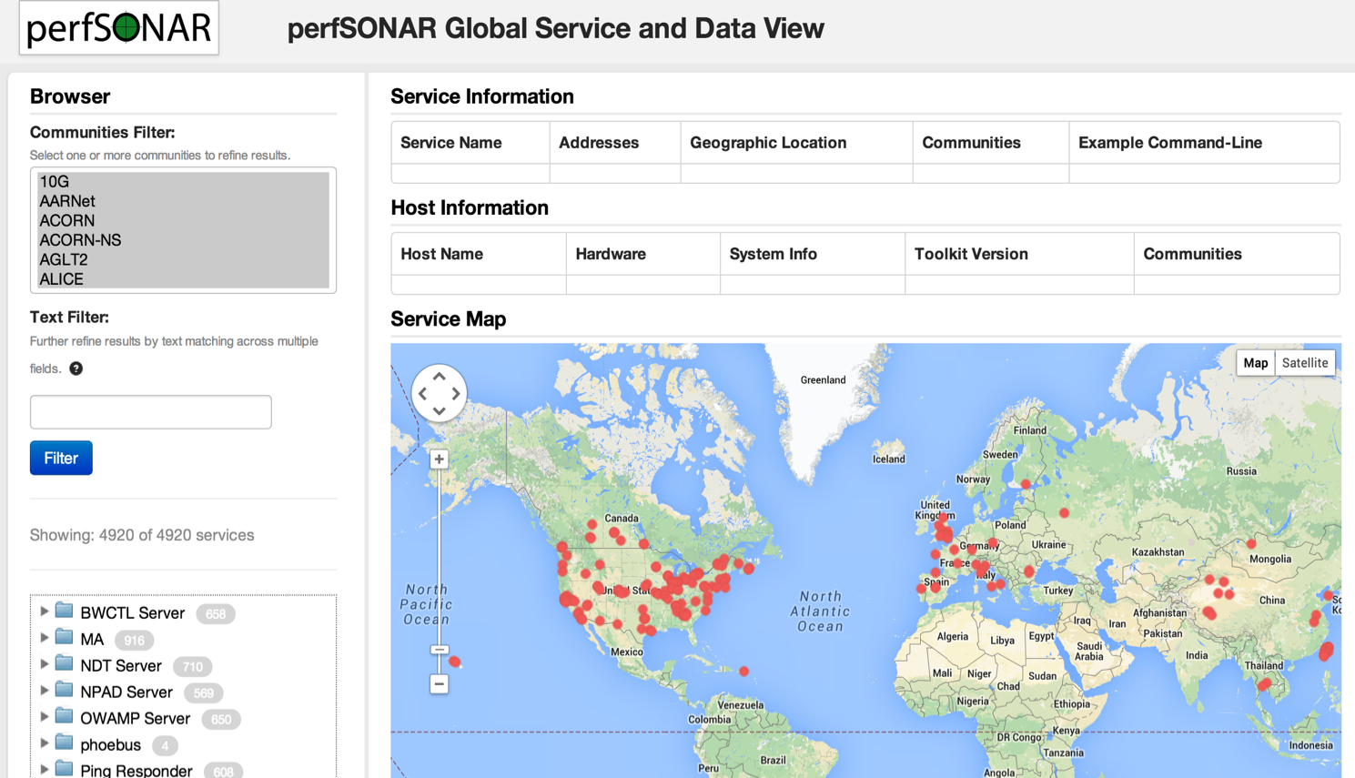
Lookup Service Directory Search: http://stats.es.net/ServicesDirectory/
© 2015, The Regents of the University of California, through Lawrence Berkeley National Laboratory and is licensed under CC BY-NC-ND 4.0
<number> – ESnet Science Engagement (engage@es.net) - 06/01/2018
Notes:
How to find perfSONAR servers and services
<number>

Slide 37
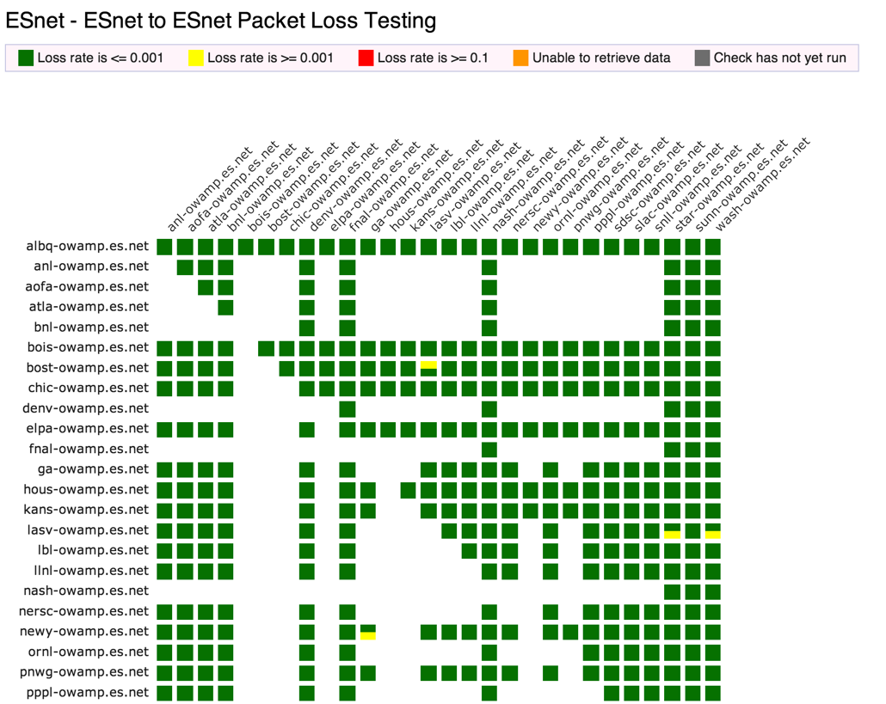
perfSONAR Dashboard: http://ps-dashboard.es.net
© 2015, The Regents of the University of California, through Lawrence Berkeley National Laboratory and is licensed under CC BY-NC-ND 4.0
<number> – ESnet Science Engagement (engage@es.net) - 06/01/2018
Notes:
Integrating regular testing into a visualization (ESnet example).
Performance data is public
The tool can trigger alerts to notify NOC staff.
This is a very valuable tool for setting expectations
<number>

Slide 38
Overview
Science DMZ Motivation and Introduction
Science DMZ Architecture
Network Monitoring
Data Transfer Nodes & Applications
Science DMZ Security
User Engagement
Wrap Up
© 2015, The Regents of the University of California, through Lawrence Berkeley National Laboratory and is licensed under CC BY-NC-ND 4.0
<number> – ESnet Science Engagement (engage@es.net) - 06/01/2018
Notes:
<number>

Slide 39
Dedicated Systems – Data Transfer Node
The DTN is dedicated to data transfer
Set up specifically for high-performance data movement
System internals (BIOS, firmware, interrupts, etc.)
Network stack
Storage (global filesystem, Fibrechannel, local RAID, etc.)
High performance tools
No extraneous software
Limitation of scope and function is powerful
No conflicts with configuration for other tasks
Small application set makes cybersecurity easier
© 2015, The Regents of the University of California, through Lawrence Berkeley National Laboratory and is licensed under CC BY-NC-ND 4.0
<number> – ESnet Science Engagement (engage@es.net) - 06/01/2018
Notes:
All aspects of the DTN must be tuned – even the BIOS matters
Limit the scope of the DTN as well – its job is data movement, its job is not to have office software on it.
Craft a specific security profile/policy around its only task.
<number>

Slide 40
Data Transfer Tools For DTNs
Parallelism is important
It is often easier to achieve a given performance level with four parallel connections than one connection
Several tools offer parallel transfers, including Globus/GridFTP
Latency interaction is critical
Wide area data transfers have much higher latency than LAN transfers
Many tools and protocols assume a LAN
Workflow integration is important
Key tools: Globus Online, HPN-SSH
© 2015, The Regents of the University of California, through Lawrence Berkeley National Laboratory and is licensed under CC BY-NC-ND 4.0
<number> – ESnet Science Engagement (engage@es.net) - 06/01/2018
Notes:
DTN is entry point for data from multi-facility workflows – use the right tool for the right job
<number>

Slide 41

Data Transfer Tool Comparison
In addition to the network, using the right data transfer tool is critical
Data transfer test from Berkeley, CA to Argonne, IL (near Chicago). RTT = 53 ms, network capacity = 10Gbps.
Tool Throughput
scp: 140 Mbps
HPN patched scp: 1.2 Gbps
ftp 1.4 Gbps
GridFTP, 4 streams 5.4 Gbps
GridFTP, 8 streams 6.6 Gbps
Note that to get more than 1 Gbps (125 MB/s) disk to disk requires properly engineered storage (RAID, parallel filesystem, etc.)
© 2015, The Regents of the University of California, through Lawrence Berkeley National Laboratory and is licensed under CC BY-NC-ND 4.0
<number> – ESnet Science Engagement (engage@es.net) - 06/01/2018
Notes:
<number>
Comparison of legacy and recommended tools.
Note that rsync over HPN-SSH is reasonable in a 1Gbps environment – if you are stuck with rsync over SSH, at least use HPN-SSH.
Globus is now deployed at a large number of major scientific sites – the basic data transfer functionality is free.

Slide 42
Overview
Science DMZ Motivation and Introduction
Science DMZ Architecture
Network Monitoring
Data Transfer Nodes & Applications
Science DMZ Security
User Engagement
Wrap Up
© 2015, The Regents of the University of California, through Lawrence Berkeley National Laboratory and is licensed under CC BY-NC-ND 4.0
<number> – ESnet Science Engagement (engage@es.net) - 06/01/2018
Notes:
<number>

Slide 43
Science DMZ Security
Goal – disentangle security policy and enforcement for science flows from security for business systems
Rationale
Science data traffic is simple from a security perspective
Narrow application set on Science DMZ
Data transfer, data streaming packages
No printers, document readers, web browsers, building control systems, financial databases, staff desktops, etc.
Security controls that are typically implemented to protect business resources often cause performance problems
Separation allows each to be optimized
© 2015, The Regents of the University of California, through Lawrence Berkeley National Laboratory and is licensed under CC BY-NC-ND 4.0
<number> – ESnet Science Engagement (engage@es.net) - 06/01/2018

Slide 44
Placement Outside the Firewall
The Science DMZ resources are placed outside the enterprise firewall for performance reasons
The meaning of this is specific – Science DMZ traffic does not traverse the firewall data plane
Packet filtering is fine – just don’t do it with a firewall
Lots of heartburn over this, especially from the perspective of a conventional firewall manager
Lots of organizational policy directives mandating firewalls
Firewalls are designed to protect converged enterprise networks
Why would you put critical assets outside the firewall???
The answer is that firewalls are typically a poor fit for high-performance science applications
© 2015, The Regents of the University of California, through Lawrence Berkeley National Laboratory and is licensed under CC BY-NC-ND 4.0
<number> – ESnet Science Engagement (engage@es.net) - 06/01/2018
Notes:
Packets do not traverse a firewall device
Firewalls are typically engineered very differently than routers and switches
<number>

Slide 45
Firewall Internals
Typical firewalls are composed of a set of processors which inspect traffic in parallel
Traffic distributed among processors such that all traffic for a particular connection goes to the same processor
Simplifies state management
Parallelization scales deep analysis
Excellent fit for enterprise traffic profile
High connection count, low per-connection data rate
Complex protocols with embedded threats
Each processor is a fraction of firewall link speed
Significant limitation for data-intensive science applications
Overload causes packet loss – performance crashes
© 2015, The Regents of the University of California, through Lawrence Berkeley National Laboratory and is licensed under CC BY-NC-ND 4.0
<number> – ESnet Science Engagement (engage@es.net) - 06/01/2018
Notes:
Each individual processor is typically a fraction of link speed (e.g. eight 1.25Gbps processors for a 10G firewall)
<number>

Slide 46
What’s Inside Your Firewall?
Vendor: “but wait – we don’t do this anymore!”
It is true that vendors are working toward line-rate 10G firewalls, and some may even have them now
10GE has been deployed in science environments for over 10 years
Firewall internals have only recently started to catch up with the 10G world
100GE is being deployed now, 40Gbps host interfaces are available now
Firewalls are behind again
In general, IT shops want to get 5+ years out of a firewall purchase
This often means that the firewall is years behind the technology curve
Whatever you deploy now, that’s the hardware feature set you get
When a new science project tries to deploy data-intensive resources, they get whatever feature set was purchased several years ago
© 2015, The Regents of the University of California, through Lawrence Berkeley National Laboratory and is licensed under CC BY-NC-ND 4.0
<number> – ESnet Science Engagement (engage@es.net) - 06/01/2018
Notes:
As an element of network design, the enterprise firewall is a poor fit for high-performance scientific applications
Find another way to secure the high-performance scientific applications
<number>

Slide 47
The Firewall State Table
Many firewalls use a state table to improve performance
State table lookup is fast
No need to process entire ruleset for every packet
Also allows session tracking (e.g. TCP sequence numbers)
State table built dynamically
Incoming packets are matched against the state table
If no state table entry, go to the ruleset
If permitted by ruleset, create state table entry
Remove state table entry after observing connection teardown
Semantically similar to punt-and-switch model of traffic forwarding used on many older routers
© 2015, The Regents of the University of California, through Lawrence Berkeley National Laboratory and is licensed under CC BY-NC-ND 4.0
<number> – ESnet Science Engagement (engage@es.net) - 06/01/2018

Slide 48
State Table Issues
If the state table is not pruned, it will overflow
Not all connections close cleanly
I shut my laptop and go to a meeting
Software crashes happen
Some attacks try to fill state tables
Solution: put a timer on state table entries
When a packet matches the state table entry, update the timer
If the timer expires, delete the state table entry
What if I just pause for a few minutes?
This turns out to be a problem – state table timers are typically in the 5-15 minute range, while host keepalive timers are 2 hours
If a connection pauses (e.g. control channel waits for a large transfer), the firewall will delete the state table entry from under it – the control connection now hangs
We have seen this in production environments
© 2015, The Regents of the University of California, through Lawrence Berkeley National Laboratory and is licensed under CC BY-NC-ND 4.0
<number> – ESnet Science Engagement (engage@es.net) - 06/01/2018
Notes:
Enterprise firewall designers assume that everything is an email, a web browser, or streaming content
Science environments are more complex than that – they make use of the full set of capabilities available
If you violate the assumptions of an enterprise firewall, you experience denial of service – by design!
<number>

Slide 49
Firewall Capabilities and Science Traffic
Firewalls have a lot of sophistication in an enterprise setting
Application layer protocol analysis (HTTP, POP, MSRPC, etc.)
Built-in VPN servers
User awareness
Data-intensive science flows typically don’t match this profile
Common case – data on filesystem A needs to be on filesystem Z
Data transfer tool verifies credentials over an encrypted channel
Then open a socket or set of sockets, and send data until done (1TB, 10TB, 100TB, …)
One workflow can use 10% to 50% or more of a 10G network link
Do we have to use a firewall?
© 2015, The Regents of the University of California, through Lawrence Berkeley National Laboratory and is licensed under CC BY-NC-ND 4.0
<number> – ESnet Science Engagement (engage@es.net) - 06/01/2018

Slide 50
Firewalls As Access Lists
When you ask a firewall administrator to allow data transfers through the firewall, what do they ask for?
IP address of your host
IP address of the remote host
Port range
That looks like an ACL to me!
No special config for advanced protocol analysis – just address/port
Router ACLs are better than firewalls at address/port filtering
ACL capabilities are typically built into the router
Router ACLs typically do not drop traffic permitted by policy
© 2015, The Regents of the University of California, through Lawrence Berkeley National Laboratory and is licensed under CC BY-NC-ND 4.0
<number> – ESnet Science Engagement (engage@es.net) - 06/01/2018
Notes:
Remember – we have mission requirements for high performance scientific data mobility, and business requirements for cost efficiency.
A firewall mandate is an expensive solution that is a poor match for the task at hand and jeopardizes the scientific mission of the organization.
<number>

Slide 51
Security Without Firewalls
Data intensive science traffic interacts poorly with firewalls
Does this mean we ignore security? NO!
We must protect our systems
We just need to find a way to do security that does not prevent us from getting the science done
Key point – security policies and mechanisms that protect the Science DMZ should be implemented so that they do not compromise performance
Traffic permitted by policy should not experience performance impact as a result of the application of policy
© 2015, The Regents of the University of California, through Lawrence Berkeley National Laboratory and is licensed under CC BY-NC-ND 4.0
<number> – ESnet Science Engagement (engage@es.net) - 06/01/2018
Notes:
<number>

Slide 52
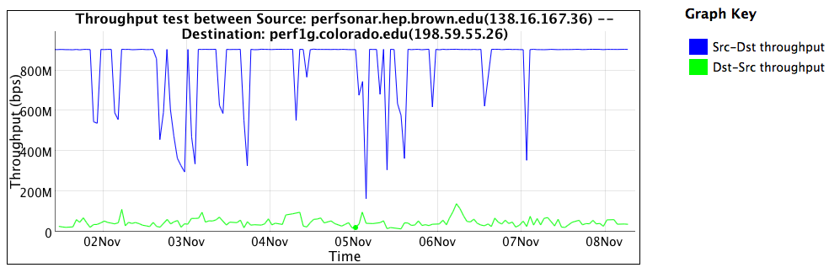
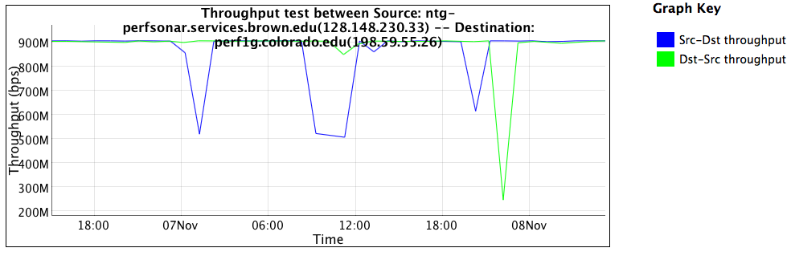
Firewall Performance Example
Observed performance, via perfSONAR, through a firewall:
Observed performance, via perfSONAR, bypassing firewall:
Almost 20 times slower through the firewall
Huge improvement without the firewall
© 2015, The Regents of the University of California, through Lawrence Berkeley National Laboratory and is licensed under CC BY-NC-ND 4.0
<number> – ESnet Science Engagement (engage@es.net) - 06/01/2018
Notes:
Real life example, in front of and in back of a firewall that was dramatically impacting performance
perfSONAR is good at finding these issues
Engineers still have to take action to fix the problem
<number>

Slide 53
If Not Firewalls, Then What?
Remember – the goal is to protect systems in a way that allows the science mission to succeed
I like something I heard at NERSC – paraphrasing: “Security controls should enhance the utility of science infrastructure.”
There are multiple ways to solve this – some are technical, and some are organizational/sociological
I’m not going to lie to you – this is harder than just putting up a firewall and closing your eyes
© 2015, The Regents of the University of California, through Lawrence Berkeley National Laboratory and is licensed under CC BY-NC-ND 4.0
<number> – ESnet Science Engagement (engage@es.net) - 06/01/2018
Notes:
It will probably work better because the firewall isn’t doing that much for high-performance DTNs anyway
<number>

Slide 54
Other Technical Capabilities
Intrusion Detection Systems (IDS)
One example is Bro – http://bro-ids.org/
Bro is high-performance and battle-tested
Bro protects several high-performance national assets
Bro can be scaled with clustering: http://www.bro-ids.org/documentation/cluster.html
Other IDS solutions are available also
Netflow and IPFIX can provide intelligence, but not filtering
Openflow and SDN
Using Openflow to control access to a network-based service seems pretty obvious
This could significantly reduce the attack surface for any authenticated network service
This would only work if the Openflow device had a robust data plane
© 2015, The Regents of the University of California, through Lawrence Berkeley National Laboratory and is licensed under CC BY-NC-ND 4.0
<number> – ESnet Science Engagement (engage@es.net) - 06/01/2018

Slide 55
Other Technical Capabilities (2)
Aggressive access lists
More useful with project-specific DTNs
If the purpose of the DTN is to exchange data with a small set of remote collaborators, the ACL is pretty easy to write
Large-scale data distribution servers are hard to handle this way (but then, the firewall ruleset for such a service would be pretty open too)
Limitation of the application set
One of the reasons to limit the application set in the Science DMZ is to make it easier to protect
Keep desktop applications off the DTN (and watch for them anyway using logging, netflow, etc – take violations seriously)
This requires collaboration between people – networking, security, systems, and scientists
© 2015, The Regents of the University of California, through Lawrence Berkeley National Laboratory and is licensed under CC BY-NC-ND 4.0
<number> – ESnet Science Engagement (engage@es.net) - 06/01/2018

Slide 56
Collaboration Within The Organization
All stakeholders should collaborate on Science DMZ design, policy, and enforcement
The security people have to be on board
Remember: security people already have political cover – it’s called the firewall
If a host gets compromised, the security officer can say they did their due diligence because there was a firewall in place
If the deployment of a Science DMZ is going to jeopardize the job of the security officer, expect pushback
The Science DMZ is a strategic asset, and should be understood by the strategic thinkers in the organization
Changes in security models
Changes in operational models
Enhanced ability to compete for funding
Increased institutional capability – greater science output
© 2015, The Regents of the University of California, through Lawrence Berkeley National Laboratory and is licensed under CC BY-NC-ND 4.0
<number> – ESnet Science Engagement (engage@es.net) - 06/01/2018

Slide 57
Overview
Science DMZ Motivation and Introduction
Science DMZ Architecture
Network Monitoring
Data Transfer Nodes & Applications
Science DMZ Security
User Engagement
Wrap Up
© 2015, The Regents of the University of California, through Lawrence Berkeley National Laboratory and is licensed under CC BY-NC-ND 4.0
<number> – ESnet Science Engagement (engage@es.net) - 06/01/2018
Notes:
<number>

Slide 58
Science DMZ Superfecta: Engagement
Engagement
Partnerships
Education & Consulting
Resources & Knowledgebase
Data Transfer Node
High performance
Configured for data transfer
Proper tools
Engagement with Network Users
Dedicated Systems for Data Transfer
Performance Testing & Measurement
perfSONAR
Enables fault isolation
Verify correct operation
Widely deployed in ESnet and other networks, as well as sites and facilities
Network Architecture
Science DMZ
Dedicated location for DTN
Proper security
Easy to deploy - no need to redesign the whole network
© 2015, The Regents of the University of California, through Lawrence Berkeley National Laboratory and is licensed under CC BY-NC-ND 4.0
<number> – ESnet Science Engagement (engage@es.net) - 06/01/2018
Notes:
The trifecta of DMZ, DTN, and perfSONAR is sufficient if your users already understand
If you want to do this right, include user engagement as an integral part of the Science DMZ so that users can be brought in - this is what ESnet does
<number>

Slide 59
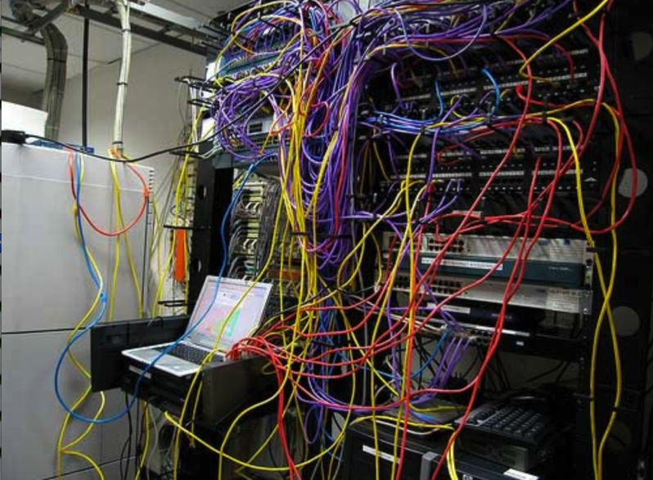
Challenges to Network Adoption
Causes of performance issues are complicated for users.
Lack of communication and collaboration between the CIO’s office and researchers on campus.
Lack of IT expertise within a science collaboration or experimental facility
User’s performance expectations are low (“The network is too slow”, “I tried it and it didn’t work”).
Cultural change is hard (“we’ve always shipped disks!”).
Scientists want to do science not IT support
The Capability Gap
© 2015, The Regents of the University of California, through Lawrence Berkeley National Laboratory and is licensed under CC BY-NC-ND 4.0
<number> – ESnet Science Engagement (engage@es.net) - 06/01/2018
Notes:
The struggle in engagement – management, engineering, and users often have dug in on bad behavior.
This amounts a capability gap – there is a disconnect from the capabilities of the network and the ability of the scientists to effectively use it
To fix this, we need to get everyone working toward a common goal:
- Management must fund and support the base needs of research
- IT is there to support the users in doing things correctly, and having all components work
<number>

Slide 60
Overview
Science DMZ Motivation and Introduction
Science DMZ Architecture
Network Monitoring
Data Transfer Nodes & Applications
On the Topic of Security
User Engagement
Wrap Up
© 2015, The Regents of the University of California, through Lawrence Berkeley National Laboratory and is licensed under CC BY-NC-ND 4.0
<number> – ESnet Science Engagement (engage@es.net) - 06/01/2018
Notes:
<number>

Slide 61
Futures
The Science DMZ design pattern is highly adaptable to new technologies
Software Defined Networking (SDN)
Non-IP protocols (RDMA over Ethernet)
Deploying new technologies in a Science DMZ is straightforward
The basic elements are the same
Capable infrastructure designed for the task
Test and measurement to verify correct operation
Security policy well-matched to the environment
Application set strictly limited to reduce security risk
Change footprint is small – often just a single router or switch
The rest of the infrastructure need not change
© 2015, The Regents of the University of California, through Lawrence Berkeley National Laboratory and is licensed under CC BY-NC-ND 4.0
<number> – ESnet Science Engagement (engage@es.net) - 06/01/2018

Slide 62
Wrapup
The Science DMZ design pattern provides a flexible model for supporting high-performance data transfers and workflows
Key elements:
Accommodation of TCP
Sufficient bandwidth to avoid congestion
Loss-free IP service
Location – near the site perimeter if possible
Test and measurement
Dedicated systems
Appropriate security
Support for advanced capabilities (e.g. SDN) is much easier with a Science DMZ
© 2015, The Regents of the University of California, through Lawrence Berkeley National Laboratory and is licensed under CC BY-NC-ND 4.0
<number> – ESnet Science Engagement (engage@es.net) - 06/01/2018

Slide 63
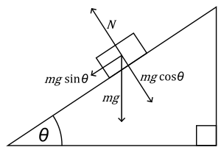
The Science DMZ in 1 Slide
Consists of three key components, all required:
“Friction free” network path
Highly capable network devices (wire-speed, deep queues)
Virtual circuit connectivity option
Security policy and enforcement specific to science workflows
Located at or near site perimeter if possible
Dedicated, high-performance Data Transfer Nodes (DTNs)
Hardware, operating system, libraries all optimized for transfer
Includes optimized data transfer tools such as Globus Online and GridFTP
Performance measurement/test node
perfSONAR
Engagement with end users
Details at http://fasterdata.es.net/science-dmz/
© 2013 Wikipedia
© 2015, The Regents of the University of California, through Lawrence Berkeley National Laboratory and is licensed under CC BY-NC-ND 4.0
<number> – ESnet Science Engagement (engage@es.net) - 06/01/2018
Notes:
Single slide summary
<number>

Slide 64
Links
ESnet fasterdata knowledge base
http://fasterdata.es.net/
Science DMZ paper
http://www.es.net/assets/pubs_presos/sc13sciDMZ-final.pdf
Science DMZ email list
https://gab.es.net/mailman/listinfo/sciencedmz
perfSONAR
http://fasterdata.es.net/performance-testing/perfsonar/
http://www.perfsonar.net
© 2015, The Regents of the University of California, through Lawrence Berkeley National Laboratory and is licensed under CC BY-NC-ND 4.0
<number> – ESnet Science Engagement (engage@es.net) - 06/01/2018

Slide 65
This document is a result of work by ESnet for the Fasterdata knowledgebase (http://fasterdata.es.net) and is licensed under CC BY-NC-ND 4.0 (https://creativecommons.org/licenses/by-nc-nd/4.0/).
© 2015, The Regents of the University of California, through Lawrence Berkeley National Laboratory (subject to receipt of any required approvals from the U.S. Dept. of Energy). All rights reserved.
NOTICE. This material is owned by the U.S. Department of Energy. As such, the U.S. Government has been granted for itself and others acting on its behalf a paid-up, nonexclusive, irrevocable, worldwide license in the material to reproduce, prepare derivative works, and perform publicly and display publicly.
Thanks!
Energy Sciences Network (ESnet)
Lawrence Berkeley National Laboratory
http://fasterdata.es.net/
http://my.es.net/
http://www.es.net/

Slide 66
Thought Experiment
We’re going to do a thought experiment
Consider a network between three buildings – A, B, and C
This is supposedly a 10Gbps network end to end (look at the links on the buildings)
Building A houses the border router – not much goes on there except the external connectivity
Lots of work happens in building B – so much that the processing is done with multiple processors to spread the load in an affordable way, and results are aggregated after
Building C is where we branch out to other buildings
Every link between buildings is 10Gbps – this is a 10Gbps network, right???
© 2015, The Regents of the University of California, through Lawrence Berkeley National Laboratory and is licensed under CC BY-NC-ND 4.0
<number> – ESnet Science Engagement (engage@es.net) - 06/01/2018
Notes:
Go to next slide, speak to the diagram
The text on this slide is for people looking at the deck who are not present at the talk
<number>

Slide 67
Notional 10G Network Between Buildings
© 2015, The Regents of the University of California, through Lawrence Berkeley National Laboratory and is licensed under CC BY-NC-ND 4.0
<number> – ESnet Science Engagement (engage@es.net) - 06/01/2018
Notes:
Building A houses the border router – not much goes on there except the external connectivity
Lots of work happens in building B – so much that the processing is done with multiple processors to spread the load in an affordable way, and results are aggregated after
Building C is where we branch out to other buildings
<number>

Slide 68
Clearly Not A 10Gbps Network
If you look at the inside of Building B, it is obvious from a network engineering perspective that this is not a 10Gbps network
Clearly the maximum per-flow data rate is 1Gbps, not 10Gbps
However, if you convert the buildings into network elements while keeping their internals intact, you get routers and firewalls
What firewall did the organization buy? What’s inside it?
Those little 1G “switches” are firewall processors
This parallel firewall architecture has been in use for years
Slower processors are cheaper
Typically fine for a commodity traffic load
Therefore, this design is cost competitive and common
© 2015, The Regents of the University of California, through Lawrence Berkeley National Laboratory and is licensed under CC BY-NC-ND 4.0
<number> – ESnet Science Engagement (engage@es.net) - 06/01/2018

Slide 69
Notional 10G Network Between Devices
© 2015, The Regents of the University of California, through Lawrence Berkeley National Laboratory and is licensed under CC BY-NC-ND 4.0
<number> – ESnet Science Engagement (engage@es.net) - 06/01/2018
Notes:
Now, convert the buildings into network devices
Building A becomes a border router
Building B becomes a firewall
Building C becomes a core router
<number>

Slide 70
Notional Network Logical Diagram
© 2015, The Regents of the University of California, through Lawrence Berkeley National Laboratory and is licensed under CC BY-NC-ND 4.0
<number> – ESnet Science Engagement (engage@es.net) - 06/01/2018
Notes:
If you’re not allowed to look inside, this is all you see
This network is broken, but unless you know to go look you’ll never know why
<number>

Slide 71
Ad Hoc DTN Deployment
This is often what gets tried first
Data transfer node deployed where the owner has space
This is often the easiest thing to do at the time
Straightforward to turn on, hard to achieve performance
If present, perfSONAR is at the border
This is a good start
Need a second one next to the DTN
Entire LAN path has to be sized for data flows
Entire LAN path is part of any troubleshooting exercise
This usually fails to provide the necessary performance.
© 2015, The Regents of the University of California, through Lawrence Berkeley National Laboratory and is licensed under CC BY-NC-ND 4.0
<number> – ESnet Science Engagement (engage@es.net) - 06/01/2018
Notes:
Call this a ‘converged’ network, its what your local vendor rep will try to sell you
Converged does not work for science – and we can point to the insertion of a fully tuned DTN host as the counter case. The host can work well, but the network won’t due to things like congestion, buffering, security devices, etc.
This is what frustrates users most of all – they bought a new $20k server to run a high-performance tool, and they will be very mad when they get the same performance they would out of something 10 years old using SCP.
<number>

